Slide 1


#RintisKarirImpian
Salaries of Varies Data Analyst Jobs
Implementing SQL
Gladi Buana

Slide 2

Case Study

Slide 3
Task
Is there any NULL data?
What are the job titles there?
Which job titles are related to data analyst?
What is the average salary per month for data analyst jobs? 4.1 What is the average salary per month for data analyst jobs based on their experience level? 4.2 What is the average salary for data analyst jobs based on their experience level and employment type?
Which country offers the interesting salary for full-time data analyst positions with medium and entry level experience?
In which year did the salary increase from mid-level to expert-level have highest increase for full time data analyst-related jobs?
Get the dataset: https://www.kaggle.com/datasets/ruchi798/data-science-job-salaries/data

Slide 4
Dataset Information
Column | Description
work_year | The year the salary was paid.
experience_level | The experience level in the job during the year with the following possible values: EN Entry-level / Junior MI Mid-level / Intermediate SE Senior-level / Expert EX Executive-level / Director
employment_type | The type of employement for the role: PT Part-time FT Full-time CT Contract FL Freelance
job_title | The role worked in during the year.
salary | The total gross salary amount paid.
salary_currency | The currency of the salary paid as an ISO 4217 currency code.
salary_in_usd | The salary in USD (FX rate divided by avg. USD rate for the respective year via fxdata.foorilla.com).
employee_residence | Employee's primary country of residence in during the work year as an ISO 3166 country code.
remote_ratio | The overall amount of work done remotely, possible values are as follows: 0 No remote work (less than 20%) 50 Partially remote 100 Fully remote (more than 80%)
company_location | The country of the employer's main office or contracting branch as an ISO 3166 country code.
company_size | The average number of people that worked for the company during the year: S less than 50 employees (small) M 50 to 250 employees (medium) L more than 250 employees (large)

Slide 5
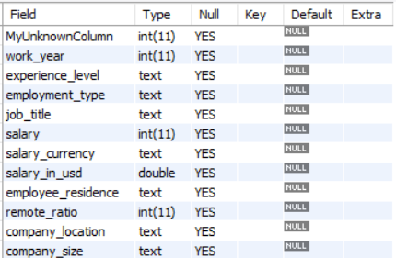
Table Data Type Information

Slide 6
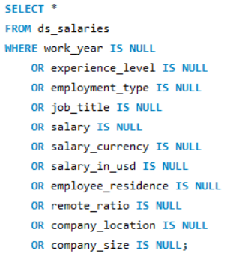
Question 1
1. Is there any NULL data?
Syntax and Table Result

Slide 7
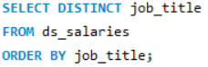
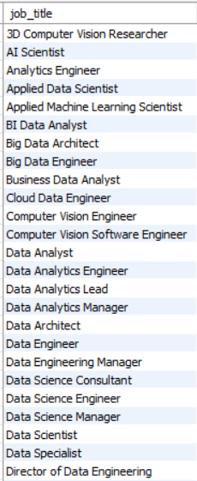
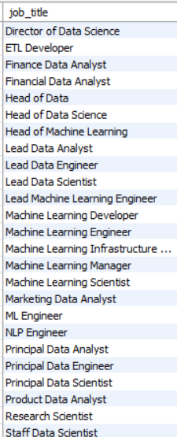
Question 2
2. What are the job titles there?
Syntax and Table Result

Slide 8
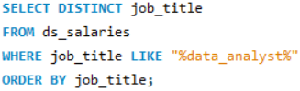
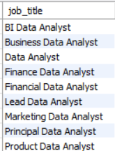
Question 3
3. Which job titles are related to data analyst?
Syntax and Table Result

Slide 9
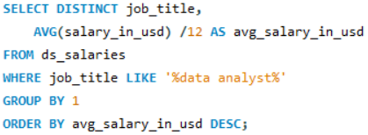
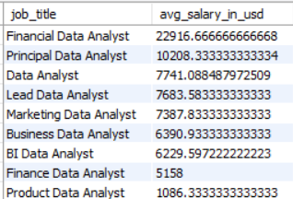
Question 4
4. What is the average salary per month for data analyst jobs? (In USD $)
Syntax and Table Result

Slide 10
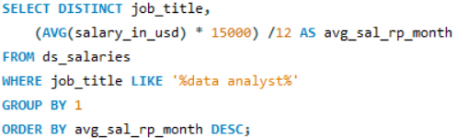
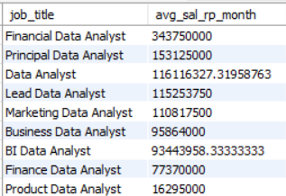
4. What is the average salary per month for data analyst jobs? (In IDR Rp)
Syntax and Table Result

Slide 11
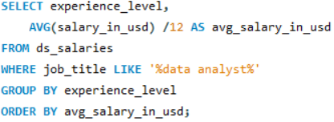
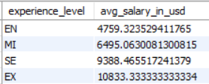
Question 4.1
4.1 What is the average salary per month for data analyst jobs based on their experience level? (In USD $)
Syntax and Table Result

Slide 12
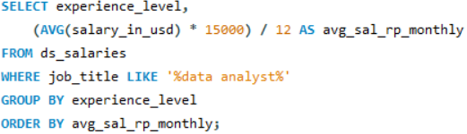
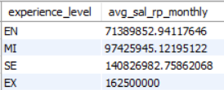
4.1 What is the average salary per month for data analyst jobs based on their experience level? (In IDR Rp)
Syntax and Table Result

Slide 13
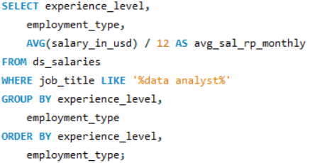
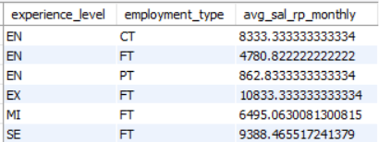
Question 4.2
4.2 What is the average salary for data analyst jobs based on their experience level and employment type? (In USD $)
Syntax and Table Result

Slide 14
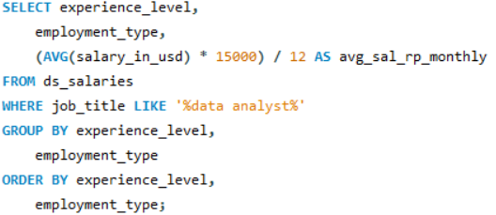
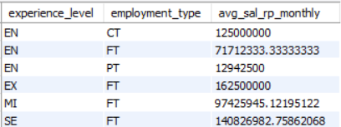
4.2 What is the average salary for data analyst jobs based on their experience level and employment type? (In IDR Rp)
Syntax and Table Result

Slide 15
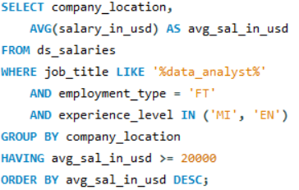
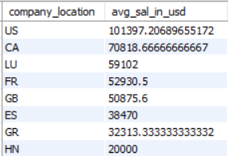
Question 5
5. Which country offers the interesting salary for full-time data analyst positions with medium and entry level experience?
Syntax and Table Result

Slide 16
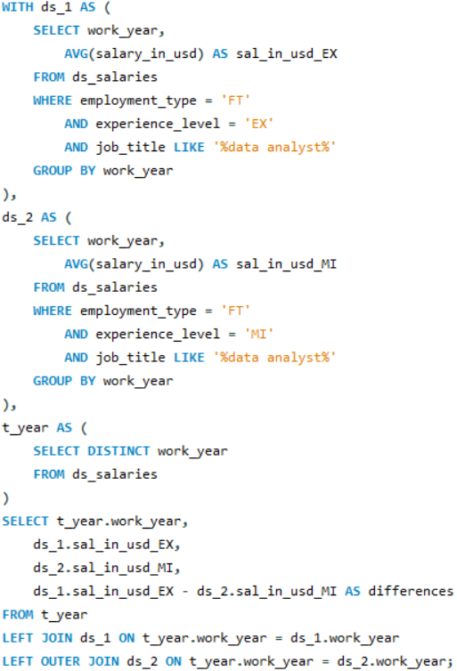
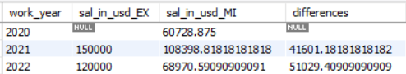
Question 6
6. In which year did the salary increase from mid-level to expert-level have highest increase for full time data analyst-related jobs?
Syntax and Table Result

Slide 17
Insights
There are 9 job titles related to data analyst in the dataset
The average salary per month for data analyst job varies from $1.1k to $22.9k
The highest average salary for data analyst is for Financial Data Analyst
The average salary per month for data analyst job varies on their experienced level from entry-level $4.8k, mid-level $6.5k, senior-level $9.4k, expert-level $10.8k
United States has the highest average salary country for data analyst jobs, following Canada, while Honduras has the lowest average salary for data analyst jobs
The highest salary increase from mid-level to expert-level for full-time data analyst jobs is in 2022.
#RintisKarirImpian

Slide 18
#RintisKarirImpian
Thank You

